Slide 1
Distance Vector Routing Protocols
Routing Protocols and Concepts – Chapter 4

Slide 2
Objectives
Identify the characteristics of distance vector routing protocols.
Describe the network discovery process of distance vector routing protocols using Routing Information Protocol (RIP).
Describe the processes to maintain accurate routing tables used by distance vector routing protocols.
Identify the conditions leading to a routing loop and explain the implications for router performance.
Recognize that distance vector routing protocols are in use today

Slide 3
Distance Vector Routing Protocols
Examples of Distance Vector routing protocols:
    Routing Information Protocol (RIP)
    Interior Gateway Routing Protocol (IGRP)
    Enhanced Interior Gateway Routing Protocol (EIGRP)
    For distance vector routing protocols, there really are only two choices: RIP or EIGRP. The decision about which routing protocol to use in a given situation is influenced by a number of factors including:
    Size of the network
    Compatibility between models of routers
    Administrative knowledge required

Slide 4
Distance Vector Routing Protocols
Distance Vector Technology
  The Meaning of Distance Vector:
    A router using distance vector routing protocols knows 2 things:
        Distance to final destination
        Vector, or direction, traffic should be directed

Slide 5
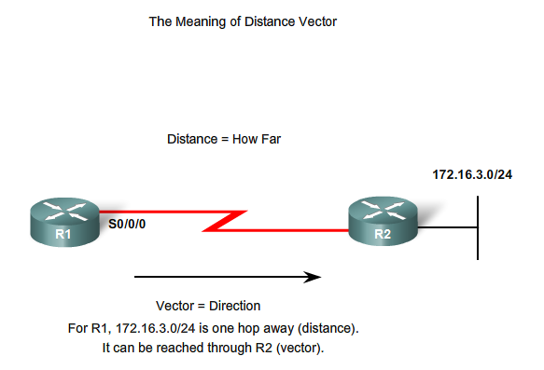
Distance + Vector

Slide 6
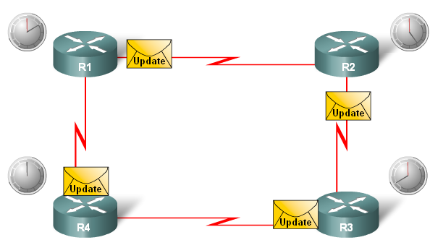
Distance Vector Routing Protocols
Characteristics of Distance Vector routing protocols:
  Periodic updates
  Neighbors
  Broadcast updates
  Entire routing table is included with routing update

Slide 7
Characteristics Contd....
Some distance vector routing protocols call for the router to periodically broadcast the entire routing table to each of its neighbours. This method is inefficient because the updates not only consume bandwidth but also consume router CPU resources to process the updates.
Distance vector routing protocols share certain characteristics.
Periodic Updates are sent at regular intervals (30 seconds for RIP and 90 seconds for IGRP). Even if the topology has not changed in several days, periodic updates continue to be sent to all neighbours.
Neighbours are routers that share a link and are configured to use the same routing protocol. The router is only aware of the network addresses of its own interfaces and the remote network addresses it can reach through its neighbours. It has no broader knowledge of the network topology. Routers using distance vector routing are not aware of the network topology.

Slide 8
Characteristics Contd....
Broadcast Updates are sent to 255.255.255.255. Neighbouring routers that are configured with the same routing protocol will process the updates.
All other devices will also process the update up to Layer 3 before discarding it. Some distance vector routing protocols use multicast addresses instead of broadcast addresses.
Entire Routing Table Updates are sent, with some exceptions to be discussed later, periodically to all neighbours.
Neighbours receiving these updates must process the entire update to find pertinent information and discard the rest. Some distance vector routing protocols like EIGRP do not send periodic routing table updates.

Slide 9
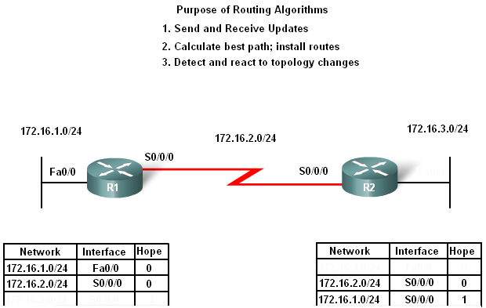
Distance Vector Routing Protocols
Routing Protocol Algorithm:
-Defined as a procedure for accomplishing a certain task

Slide 10
Distance Vector Routing Protocols
Routing Protocol Characteristics
  Criteria used to compare routing protocols includes
    -Time to convergence
    -Scalability
    -Resource usage
    -Implementation & maintenance

Slide 11
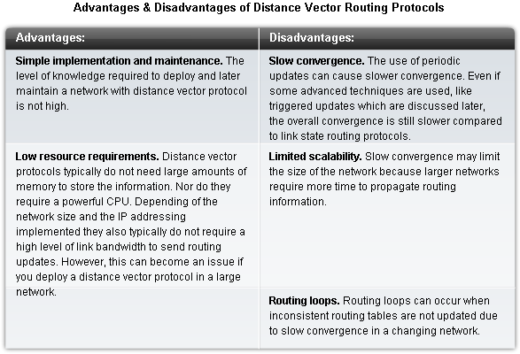
Distance Vector Routing Protocols

Slide 12
Comparison of Protocols
Routing protocols can be compared based on the following characteristics:
Time to Convergence - Time to convergence defines how quickly the routers in the network topology share routing information and reach a state of consistent knowledge. The faster the convergence, the more preferable the protocol. Routing loops can occur when inconsistent routing tables are not updated due to slow convergence in a changing network.
Scalability - Scalability defines how large a network can become based on the routing protocol that is deployed. The larger the network is, the more scalable the routing protocol needs to be.
Classless (Use of VLSM) or Classful - Classless routing protocols include the subnet mask in the updates. This feature supports the use of Variable Length Subnet Masking (VLSM) and better route summarization. Classful routing protocols do not include the subnet mask and cannot support VLSM.

Slide 13
Comparison of Protocols
4. Resource Usage - Resource usage includes the requirements of a routing protocol such as memory space, CPU utilization, and link bandwidth utilization. Higher resource requirements necessitate more powerful hardware to support the routing protocol operation in addition to the packet forwarding processes.
5. Implementation and Maintenance - Implementation and maintenance describes the level of knowledge that is required for a network administrator to implement and maintain the network based on the routing protocol deployed.

Slide 14
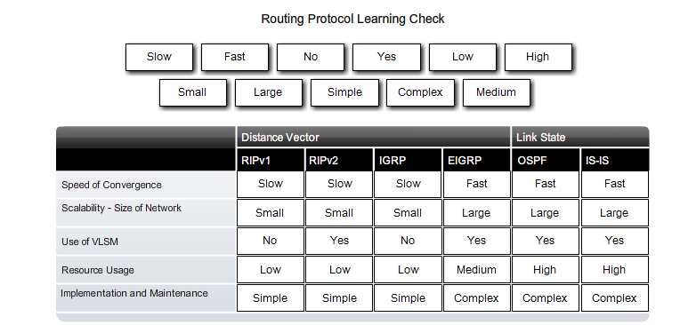
Routing Protocol Comparison

Slide 15
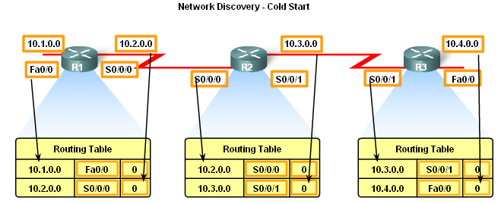
Network Discovery
Router initial start up (Cold Starts)
  -Initial network discovery
    Directly connected networks are initially placed in routing table

Slide 16
Cold Start
When a router cold starts or powers up, it knows nothing about the network topology. It does not even know that there are devices on the other end of its links.
The only information that a router has is from its own saved configuration file stored in NVRAM. Once a router boots successfully, it applies the saved configuration.
As described in Chapter 1 and Chapter 2, if the IP addressing is configured correctly, then the router will initially discover its own directly connected networks.
In the example in the figure, after a cold start and before the exchange of routing information, the routers initially discover their own directly connected networks and subnet masks.
This information is added to their routing tables.

Slide 17
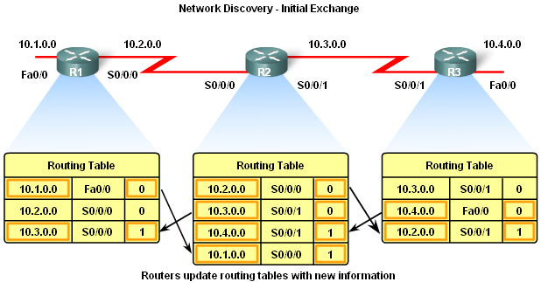
Network Discovery
Initial Exchange of Routing Information
  If a routing protocol is configured then
-Routers will exchange routing information
Routing updates received from other routers
-Router checks update for new information
      If there is new information:
-Metric is updated
-New information is
stored in routing table

Slide 18
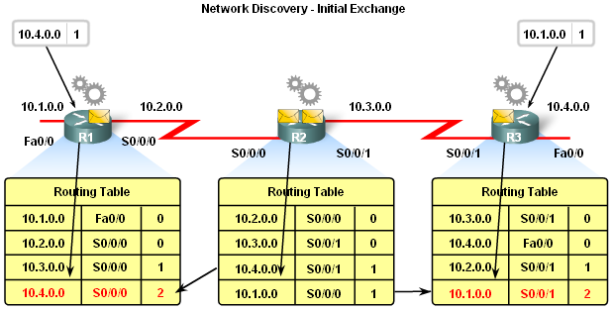
Network Discovery
Exchange of Routing Information
  Router convergence is reached when
-All routing tables in the network contain the same network information
  Routers continue to exchange routing information
-If no new information is found then Convergence is reached

Slide 19
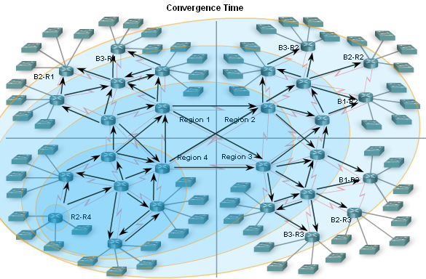
Network Discovery
Convergence must be reached before a network is considered completely operable
Speed of achieving convergence consists of 2 interdependent categories
-Speed of broadcasting routing information
-Speed of calculating routes

Slide 20
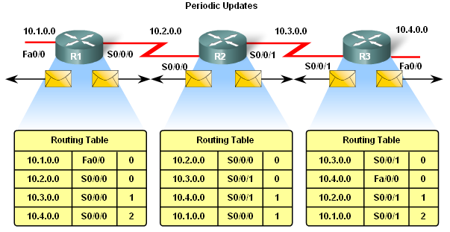
Routing Table Maintenance
Periodic Updates: RIPv1 & RIPv2
These are time intervals in which a router sends out its entire routing table.

Slide 21
Periodic Updates
Many distance vector protocols employ periodic updates to exchange routing information with their neighbours and to maintain up-to-date routing information in the routing table. RIP and IGRP are examples of two such protocols.
For RIP, these updates are sent every 30 seconds as a broadcast (255.255.255.255) whether or not there has been a topology change.
This 30-second interval is a route update timer that also aids in tracking the age of routing information in the routing table.
The age of routing information in a routing table is refreshed each time an update is received. This way information in the routing table can be maintained when there is a topology change. Changes may occur for several reasons, including:
Failure of a link
Introduction of a new link
Failure of a router
Change of link parameters

Slide 22
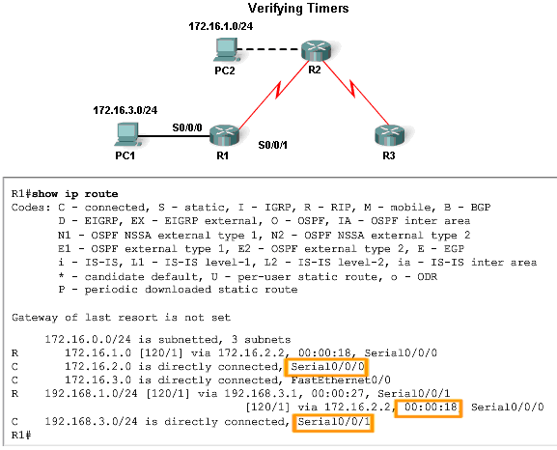
Routing Table Maintenance
RIP uses 4 timers
  -Update timer
  -Invalid timer
  -Holddown timer
  -Flush timer

Slide 23
Timers
Invalid Timer. If an update has not been received to refresh an existing route after 180 seconds (the default), the route is marked as invalid by setting the metric to 16. The route is retained in the routing table until the flush timer expires.
Flush Timer. By default, the flush timer is set for 240 seconds, which is 60 seconds longer than the invalid timer. When the flush timer expires, the route is removed from the routing table.
Holddown Timer. This timer stabilizes routing information and helps prevent routing loops during periods when the topology is converging on new information. Once a route is marked as unreachable, it must stay in holddown long enough for all routers in the topology to learn about the unreachable network. By default, the holddown timer is set for 180 seconds..

Slide 24
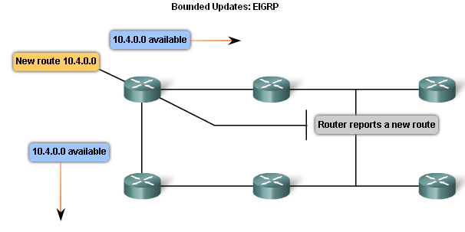
Routing Table Maintenance
Bounded Updates: EIGRP
EIRPG routing updates are
-Partial updates
-Triggered by topology changes
-Bounded
-Non periodic

Slide 25
Note on EIGRP Updates
EIGRP uses updates that are:
Non-periodic because they are not sent out on a regular basis.
Partial updates sent only when there is a change in topology that influences routing information.
Bounded, meaning the propagation of partial updates are automatically bounded so that only those routers that need the information are updated.

Slide 26
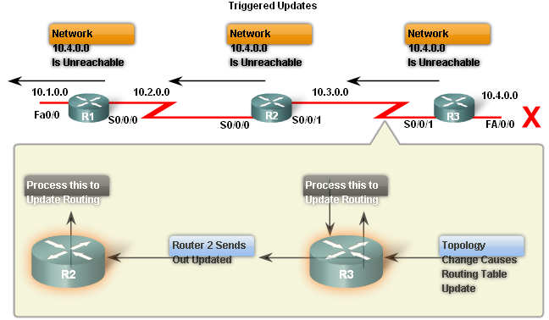
Routing Table Maintenance
Triggered Updates
  Conditions in which triggered updates are sent
-Interface changes state
-Route becomes unreachable
-Route is placed in routing table

Slide 27
Problems with Triggered Updates
Using only triggered updates would be sufficient if there were a guarantee that the wave of updates would reach every appropriate router immediately. However, there are two problems with triggered updates:
Packets containing the update message can be dropped or corrupted by some link in the network.
The triggered updates do not happen instantaneously. It is possible that a router that has not yet received the triggered update will issue a regular update at just the wrong time, causing the bad route to be reinserted in a neighbour that had already received the triggered update.

Slide 28
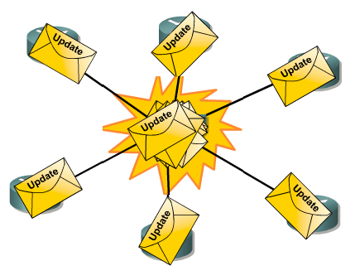
Routing Table Maintenance
Random Jitter
  Synchronized updates
    A condition where multiple routers on multi access LAN segments transmit routing updates at the same time.
    Problems with synchronized updates
      -Bandwidth consumption
      -Packet collisions
    Solution to problems with
    synchronized updates
- Used of random variable
called RIP_JITTER
(which subtracts a variable amount of time to the update interval for each router in the network. This random jitter, or variable amount of time, ranges from 0% to 15% of the specified update interval. In this way, the update interval varies randomly in a range from 25 to 30 seconds for the default 30-second interval.)

Slide 29
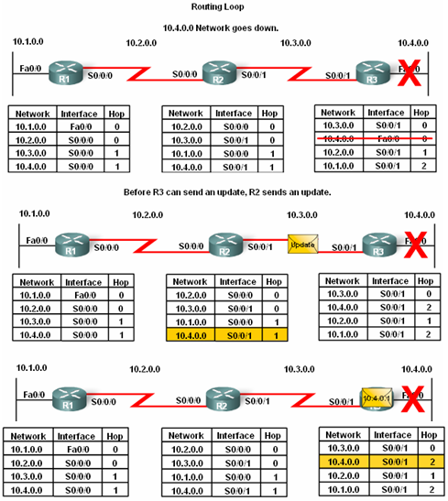
Routing Loops
Routing loops are
A condition in which a packet is continuously transmitted within a series of routers without ever reaching its destination.

Slide 30
Routing Loops
Routing loops may be caused by:
-Incorrectly configured static routes
-Incorrectly configured route redistribution
-Slow convergence
-Incorrectly configured discard routes
Routing loops can create the following issues
-Excess use of bandwidth
-CPU resources may be strained
-Network convergence is degraded
-Routing updates may be lost or not processed in a timely manner

Slide 31
Preventing Routing Loops
There are a number of mechanisms available to eliminate routing loops, primarily with distance vector routing protocols. These mechanisms include:
Defining a maximum metric to prevent count to infinity
Holddown timers
Split horizon
Route poisoning or poison reverse
Triggered updates

Slide 32
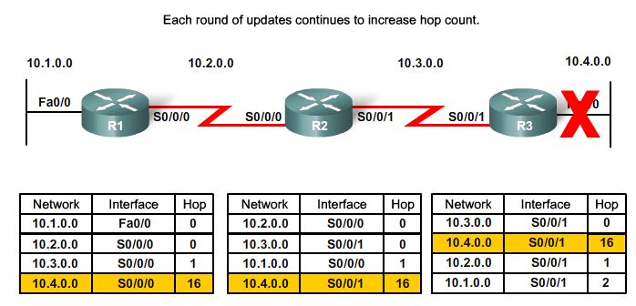
Routing Loops
Count to Infinity
This is a routing loop whereby packets bounce infinitely around a network.
Count to infinity is a condition that exists when inaccurate routing updates increase the metric value to "infinity" for a network that is no longer reachable.

Slide 33
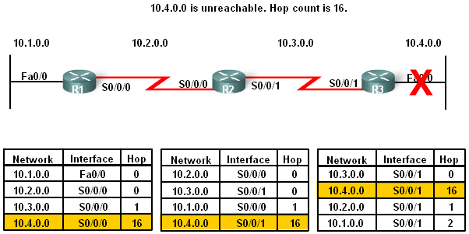
Routing Loops
Setting a maximum
Distance Vector routing protocols set a specified metric value to indicate infinity
Once a router “counts to infinity” it marks the route as unreachable

Slide 34
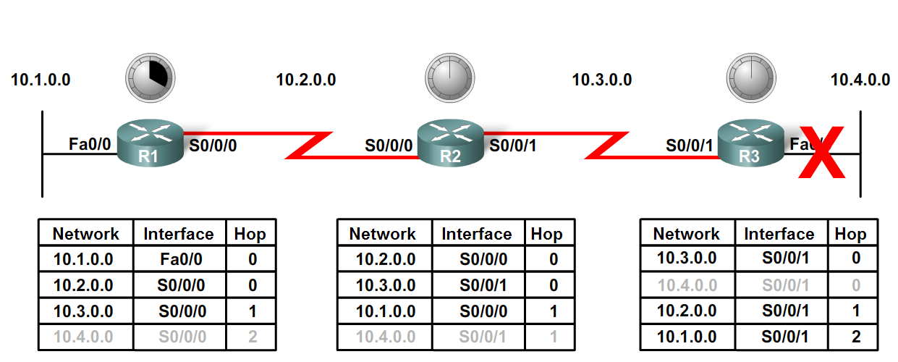
Routing Loops
Preventing loops with holddown timers
  -Holddown timers allow a router to not accept any changes to a route for a specified period of time.
  -Point of using holddown timers
    Allows routing updates to propagate through network with the most current information.

Slide 35
Holddown Timers
Holddown timers are used to prevent regular update messages from inappropriately reinstating a route that may have gone bad.
Holddown timers instruct routers to hold any changes that might affect routes for a specified period of time.
If a route is identified as down or possibly down, any other information for that route containing the same status, or worse, is ignored for a predetermined amount of time (the holddown period).
This means that routers will leave a route marked as unreachable in that state for a period of time that is long enough for updates to propagate the routing tables with the most current information.

Slide 36
How it Works
A router receives an update from a neighbour indicating that a network that previously was accessible is now no longer accessible.
The router marks the network as possibly down and starts the holddown timer.
If an update with a better metric for that network is received from any neighbouring router during the holddown period, the network is reinstated and the holddown timer is removed.
If an update from any other neighbour is received during the holddown period with the same or worse metric for that network, that update is ignored. Thus, more time is allowed for the information about the change to be propagated.
Routers still forward packets to destination networks that are marked as possibly down. This allows the router to overcome any issues associated with intermittent connectivity. If the destination network truly is unavailable and the packets are forwarded, black hole routing is created and lasts until the holddown timer expires.

Slide 37
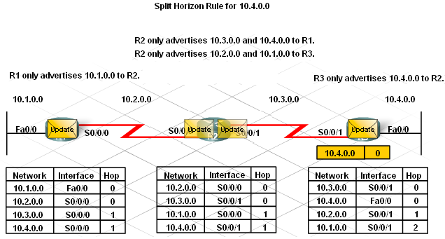
Routing Loops
The Split Horizon Rule is used to prevent routing loops
Split Horizon rule:
A router should not advertise a network through the interface from which the update came.

Slide 38
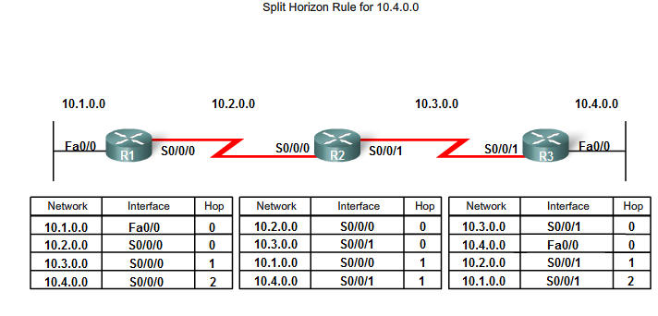
Split Horizon Example

Slide 39
How it Works
R3 advertises the 10.4.0.0 network to R2.
R2 receives the information and updates its routing table.
R2 then advertises the 10.4.0.0 network to R1 out S0/0/0. R2 does not advertise 10.4.0.0 to R3 out S0/0/1, because the route originated from that interface.
R1 receives the information and updates its routing table.
Because of split horizon, R1 also does not advertise the information about network 10.4.0.0 back to R2.
Complete routing updates are exchanged, with the exception of routes that violate the split horizon rule. The results look like this:
R2 advertises networks 10.3.0.0 and 10.4.0.0 to R1.
R2 advertises networks 10.1.0.0 and 10.2.0.0 to R3.
R1 advertises network 10.1.0.0 to R2.
R3 advertises network 10.4.0.0 to R2.

Slide 40
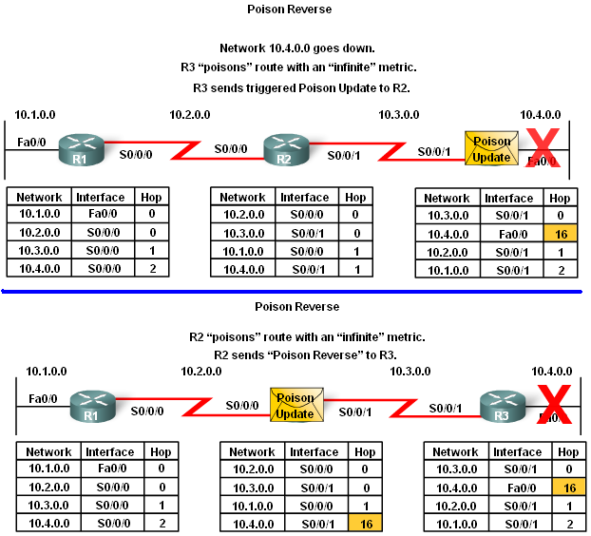
Routing Loops
Split horizon with poison reverse
The rule states that once a router learns of an unreachable route through an interface, advertise it as unreachable back through the same interface

Slide 41
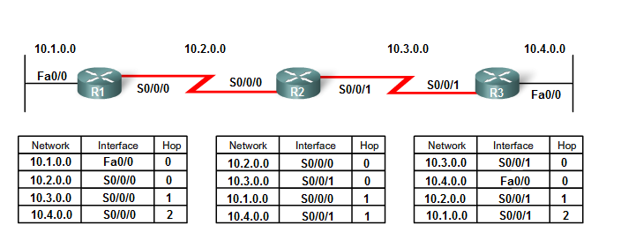
Route Poisoning
Route poisoning is yet another method employed by distance vector routing protocols to prevent routing loops.
Route poisoning is used to mark the route as unreachable in a routing update that is sent to other routers.
Unreachable is interpreted as a metric that is set to the maximum. For RIP, a poisoned route has a metric of 16.

Slide 42
How it Works
Network 10.4.0.0 becomes unavailable due to a link failure.
R3 poisons the metric with a value of 16 and then sends out a triggered update stating that 10.4.0.0 is unavailable.
R2 processes that update. Because the metric is 16, R2 invalidates the routing entry in its routing table.
R2 then sends the poison update to R1, indicating that route is unavailable, again by setting the metric value to 16.
R1 processes the update and invalidates the routing entry for 10.4.0.0 in its routing table.
Route poisoning speeds up the convergence process as the information about 10.4.0.0 spreads through the network more quickly than waiting for the hop count to reach "infinity".

Slide 43
Routing Loops
IP & TTL
  Purpose of the TTL field
The TTL field is found in an IP header and is used to prevent packets from endlessly traveling on a network
How the TTL field works
-TTL field contains a numeric value
The numeric value is decreased by one by every router on the route to the destination.
If numeric value reaches 0 then Packet is discarded.

Slide 44
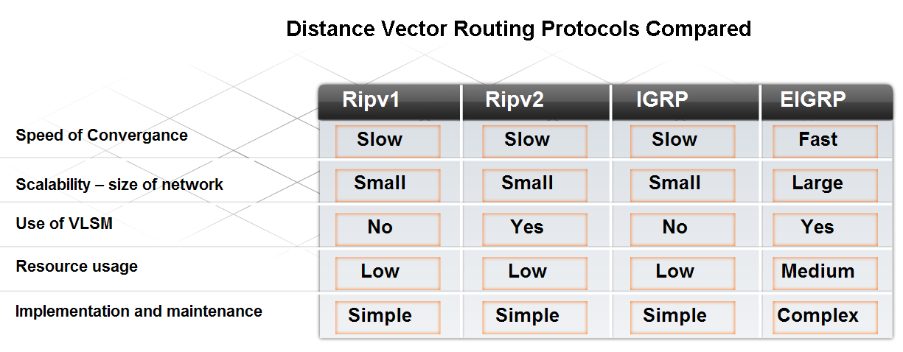
Routing Protocols Today
Factors used to determine whether to use RIP or EIGRP include
-Network size
-Compatibility between models of routers
-Administrative knowledge

Slide 45
Routing Protocols Today
RIP
  Features of RIP:
-Supports split horizon & split horizon with poison reverse
-Capable of load balancing
-Easy to configure
-Works in a multi vendor router environment

Slide 46
Routing Protocols Today
EIGRP
  Features of EIGRP:
-Triggered updates
-EIGRP hello protocol used to establish neighbor adjacencies
-Supports VLSM & route summarization
-Use of topology table to maintain all routes
-Classless distance vector routing protocol
-Cisco proprietary protocol

Slide 47
Summary
Characteristics of Distance Vector routing protocols
  Periodic updates
  RIP routing updates include the entire routing table
  Neighbors are defined as routers that share a link and are configured to use the same protocol
The network discovery process for D.V. routing protocol
  Directly connected routes are placed in routing table 1st
  If a routing protocol is configured then
    Routers will exchange routing information
  Convergence is reached when all network routers have the
  same network information

Slide 48
Summary
D.V. routing protocols maintains routing tables by
  RIP sending out periodic updates
  RIP using 4 different timers to ensure information is accurate and convergence is achieved in a timely manner
  EIGRP sending out triggered updates
D.V. routing protocols may be prone to routing loops
  routing loops are a condition in which packets continuously traverse a network
  Mechanisms used to minimize routing loops include defining maximum hop count, holddown timers, split horizon, route poisoning and triggered updates

Slide 49
Summary
Conditions that can lead to routing loops include
  Incorrectly configured static routes
  Incorrectly configured route redistribution
  Slow convergence
  Incorrectly configured discard routes
How routing loops can impact network performance includes:
  Excess use of bandwidth
  CPU resources may be strained
  Network convergence is degraded
  Routing updates may be lost or not processed

Slide 50
Summary
Routing Information Protocol (RIP)
  A distance vector protocol that has 2 versions
  RIPv1 – a classful routing protocol
  RIPv2 - a classless routing protocol
Enhanced Interior Gateway Routing Protocol (EIGRP)
  A distance vector routing protocols that has some features of link state routing protocols
  A Cisco proprietary routing protocol

